Slide 1
Notes:
Clementine is being read with permission from Little, Brown Books for Young Readers.

Slide 2
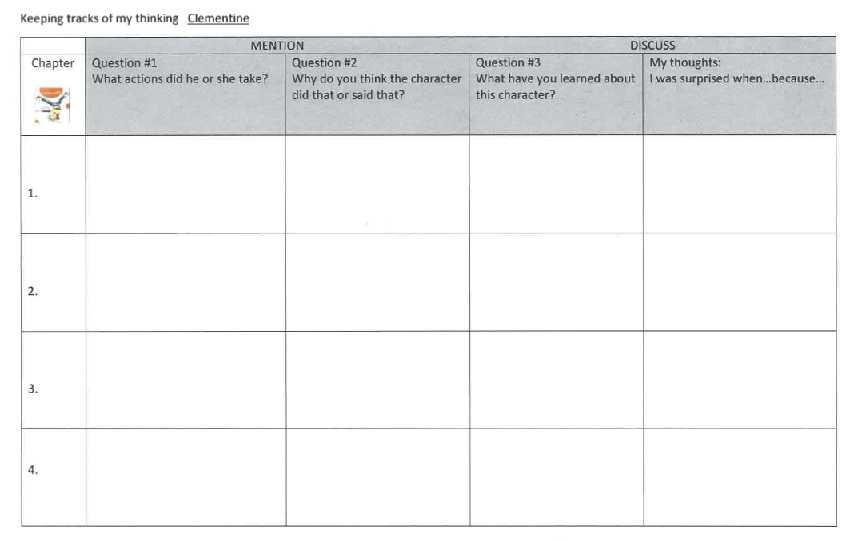
What you need…
Pencil
Paper/Journal
OR
Keeping Tracks of My Thinking
Notes:
3rd grade friends, as we read today, you will need a pencil and either your journal or the Keeping Tracks of My Thinking Graphic Organizer your teacher shared with you.

Slide 3
Clementine followed Margaret into the girls' room to see if she was o.k. She tried to help by evening out her hair when Margaret asked her to.
Clementine did that because she felt bad for Margaret. She didn't want her to feel ashamed of her lopsided hair.
Even though Clementine gets distracted and does things teachers don't like, she is a caring person because she wanted to make Margaret feel better.
I was surprised when Clementine got in trouble for Margaret's hair because she only did because Margaret asked her to!
Clementine followed Margaret into the girls' room to see if she was o.k. She tried to help by evening out her hair when Margaret asked her to.
Clementine did that because she felt bad for Margaret. She didn't want her to feel ashamed of her lopsided hair.
Even though Clementine gets distracted and does things teachers don't like, she is a caring person because she wanted to make Margaret feel better.
I was surprised when Clementine got in trouble for Margaret's hair because she only did because Margaret asked her to!
I was surprised when Clementine thought, “I like her anyway, but it’s not always easy” because it made me think that Clementine might be a little jealous of how perfect Margaret always is.
Clementine colored Margaret’s hair red and drew curls on her forehead. Margaret looked in the mirror and said, “Okay, good.”
Clementine colored Margaret’s hair to make her feel better. Margaret was feeling bad how her hair looked and was hoping to make it look better.
Clementine keeps helping Margaret because they are good friends.
Clementine shuts the door hard and says, “Margaret’s mother always wears a dress!”
Clementine is feeling angry about how Margaret’s mother thinks she is naughty. She also feels jealous of Margaret and how her life seems perfect.
Even though sometimes Clementine wishes her family were different, in the end, she realizes that she loves them just like they are.
I was surprised when Clementine wanted to try eating lentils with a toothbrush because it is so WEIRD!
At the end, she thinks the living room looks exquisite with a drawing table in it.
At the end, she realizes her family is perfect for her.
Notes:
Yesterday we read Chapter 3 and you filled in the row for Chapter 3 in your journal or in your organizer. We focused on how characters change, and I wrote about how Clementine was feeling jealous of Margaret’s perfect clothes, perfect hair, perfect apartment. She even snapped at her mom for having a drawing table in the living room! But, after talking with her mom, Clementine realized she loves her family just the way they are. I was surprised when Clementine wanted to try eating lentils with a toothbrush because it is so weird. Yuck!

Slide 4
Clementine followed Margaret into the girls' room to see if she was o.k. She tried to help by evening out her hair when Margaret asked her to.
Clementine did that because she felt bad for Margaret. She didn't want her to feel ashamed of her lopsided hair.
Even though Clementine gets distracted and does things teachers don't like, she is a caring person because she wanted to make Margaret feel better.
I was surprised when Clementine got in trouble for Margaret's hair because she only did because Margaret asked her to!
4.
Notes:
Now you all have the hang of reading and taking notes in your journal or organizer. Today, we’ll read the whole chapter. When you think that one of the characters does or says something important, you can pause the video and add that to the first column to answer “What actions did he or she take?”

Slide 5
Clementine followed Margaret into the girls' room to see if she was o.k. She tried to help by evening out her hair when Margaret asked her to.
Clementine did that because she felt bad for Margaret. She didn't want her to feel ashamed of her lopsided hair.
Even though Clementine gets distracted and does things teachers don't like, she is a caring person because she wanted to make Margaret feel better.
I was surprised when Clementine got in trouble for Margaret's hair because she only did because Margaret asked her to!
4.
Feels | Acts | Says | Thinks
jealous, hopeful, unlucky, embarrassed | jumped, sat, slammed, listened, heard, played | yelled, said, sighed, groaned | thought, considered, pondered
Notes:
While we read today, let’s think about using interesting vocabulary to describe how the character feels, acts, says, or thinks. Some examples of interesting vocabulary to describe how the character feels are…

Slide 7
Clementine followed Margaret into the girls' room to see if she was o.k. She tried to help by evening out her hair when Margaret asked her to.
Clementine did that because she felt bad for Margaret. She didn't want her to feel ashamed of her lopsided hair.
Even though Clementine gets distracted and does things teachers don't like, she is a caring person because she wanted to make Margaret feel better.
I was surprised when Clementine got in trouble for Margaret's hair because she only did because Margaret asked her to!
4.
5.
6.
Notes:
It’s your turn to add your notes for Chapter 4. Remember to try to use interesting vocabulary as you write about what the character feels, does, says, or thinks. Be prepared to show your teacher.

